Slide 1
ALOK PUBLIC SCHOOL
Certificate
This is to certify that the project work titled python programs has been satisfactorily completed by
Master - SAMEER SEKHAR SAHU
Studying in - ALOK PUBLIC SCHOOL Class - XI
Div. - AP
Roll no. – 13
During the Academic year - 2022-2023
The Principal
Teacher in charge
External Teacher

Slide 2

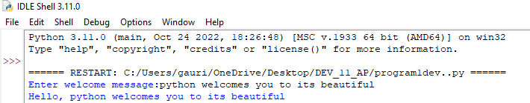
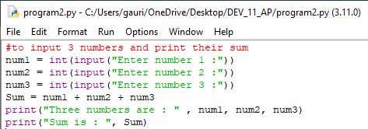
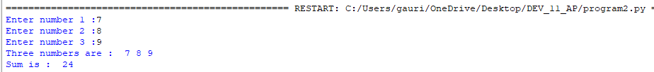
1.Write a program to input a welcome message and print it.
o Result –
2. Program to obtain three number and print their sum.
o Result-

Slide 3
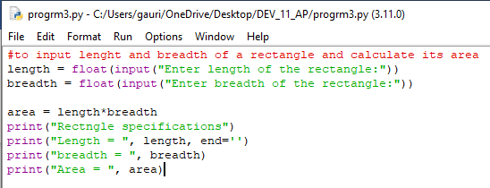
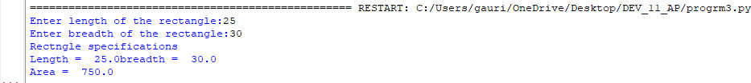
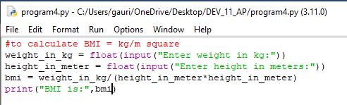
3. Program to obtain length and breadth of a rectangle and calculate its area.
o Result-
4. Program to calculate BMI
o Result

Slide 4
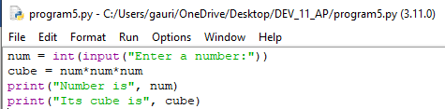
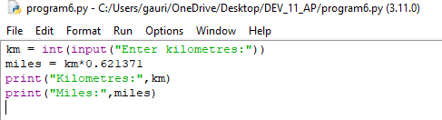
5. Write a program to input a number and print its cube.
o Result-
6. Write program to input a value in kilometer and convert it into miles.
o Result-

Slide 5
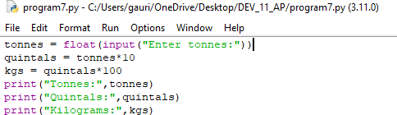
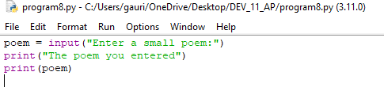
7. Write a program to input a value in tonnes and convert it into quintals and kilogram
o Result-
8. Write a program to enter a small poem and print it.
o Result-

Slide 6
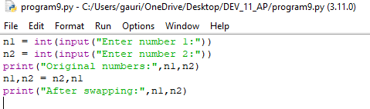
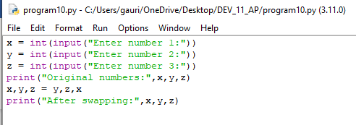
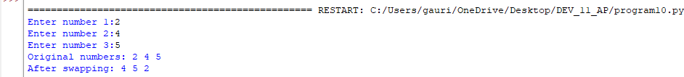
9. Write a program to input 2 number and swap them.
o Result-
10. Write a program to input three number and swap them.
o Result-

Slide 7
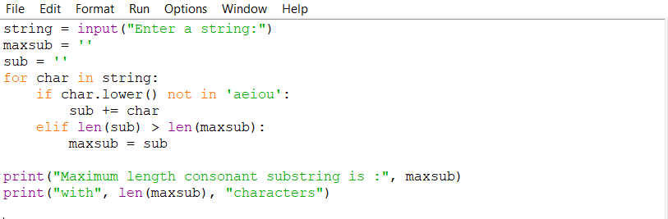
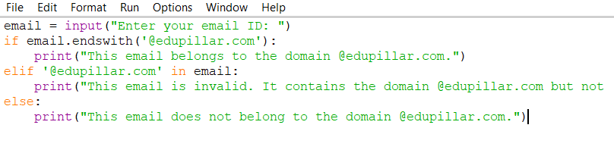
11.Write a program that reads a string and displays the longest substring of the given string having just the consonants.
o Result-
12.write a program that reads email ID of a person in form of a string and ensures that it belongs to a domain @edupillar.com
o Result-

Slide 8
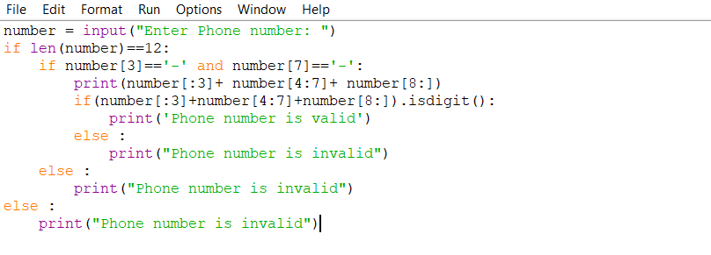
13.Write a program that prompts for a number and check if it’s valid or not
o Result-

Slide 9
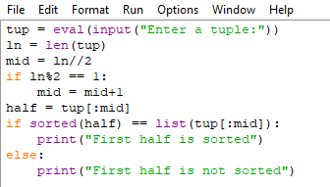


14.Write a program to check if the element in the first half of a tuple are sorted in ascending order or not.
o Result

Slide 10
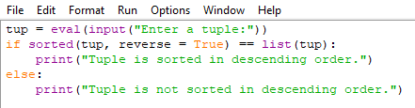


15.Write a program to check if all the element of a tuple are in descending order or not.
o Result
o

Slide 11
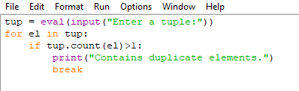
16.Write a program to check if a tuple contains any duplicate element.
o Result

Slide 12
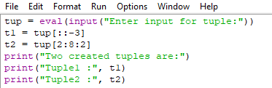

17.Write a program to input a tuple and create a two new tuple from it, one containing its every 3rd element in reverse order, starting from the last element another containing every alternate element lying between 3rd to 9th element.
o Result-

Slide 13
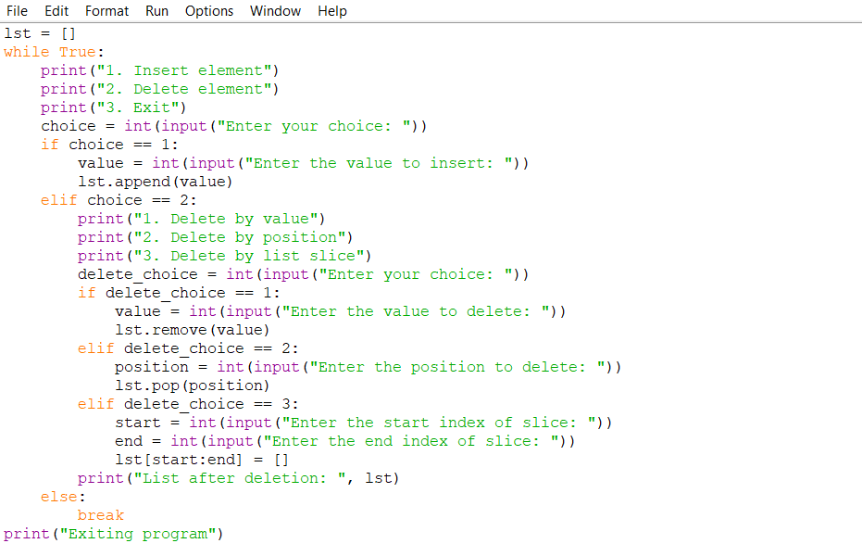
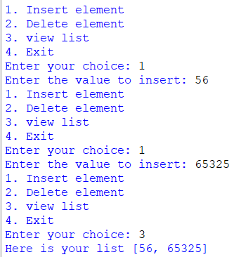
18. Write a programme that displays option for inserting or deleting elements in a list. If the user chooses a deletion option, display a sub menu and ask if element is to be deleted with value or by using its position or a list slice is to be deleted
o Result-

Slide 14
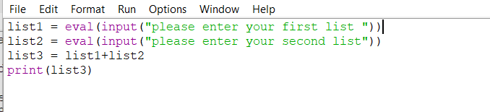

19. Write a programme that inputs to list and create a third that contains all the elements of the first followed by the elements of the second.
o Result-

Slide 15
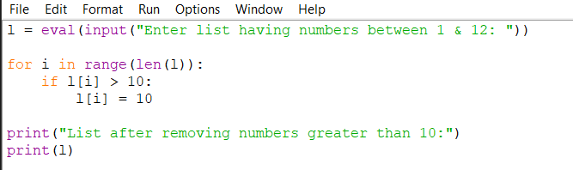
20. Ask the user to enter a list containing number between one and 12. Then replace all the entries in that list that are greater than 10 with 10.
o Result-

Slide 16
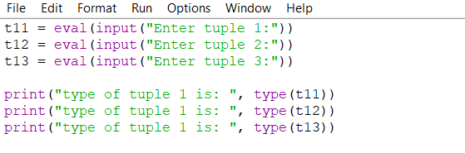
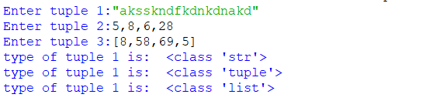
21. What will be the types of T1,T2 and T3 created as per the code given below, considering the three inputs of example one
o Result-

Slide 17
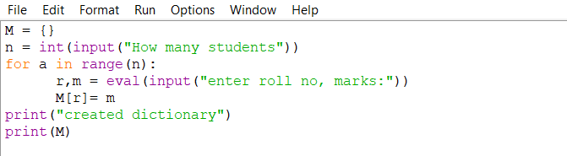
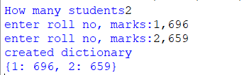
22. Write a programme to create a dictionary M which stores the marks of students of class with roll number as the keys and marks on the values. Get the number of students as input.
o Result-

Slide 18
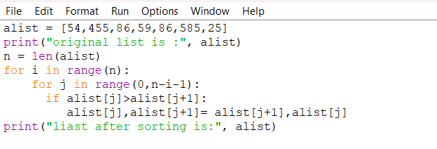
23. Programme to sort a list using bubble sort.
o Result-

Slide 19
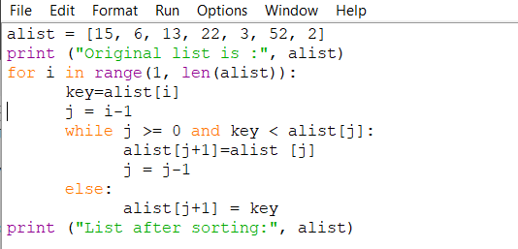
24. Programme to sort a sequence using insertion sort.
o Result-

